Slide 1

웹 프로그래밍
한글과컴퓨터학원
조교 이서현

Slide 2
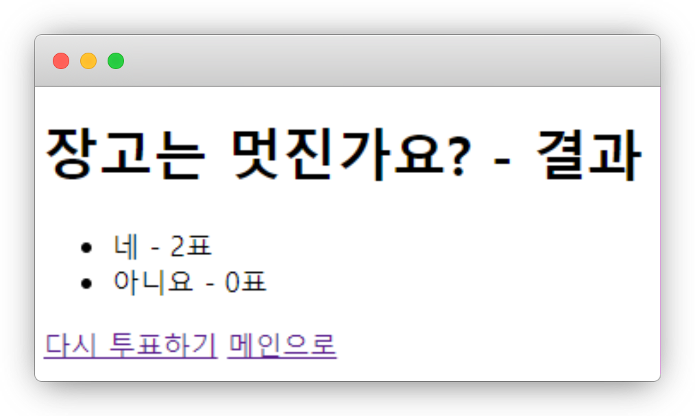
실습1
localhost:9000/polls/1/results

Slide 3
실습1
helloworld/polls/templates/polls/results.html
<h1>{{question.question_text}} - 결과</h1> <ul> {% for choice in question.choice_set.all %} <li>{{choice.choice_text}} - {{choice.votes}}표</li> {% endfor %} </ul> <a href="{% url 'polls:detail' question.id %}">다시 투표하기</a> <a href="{% url 'polls:index' %}">메인으로</a>

Slide 4
polls
helloworld/polls/templates/polls/results.html
<a href="{% url 'polls:delete' question.id %}">이 질문 삭제</a>

Slide 5
polls
helloworld/polls/urls.py
path('<int:question_id>/delete', views.delete, name='delete'),

Slide 6
polls
helloworld/polls/views.py
def delete(request, question_id): question = get_object_or_404(Question, pk=question_id) question.delete() return HttpResponseRedirect(reverse('polls:index'))

Slide 7
polls
helloworld/polls/views.py
question.delete()

Slide 8
polls
helloworld/polls/views.py
Read
Delete
Create
Update
get_object_or_404(Question, pk=question_id)
question.delete()
question.save()

Slide 9
polls
helloworld/polls/views.py
CRUD

Slide 10
polls
helloworld/polls/views.py
CRUD

Slide 11
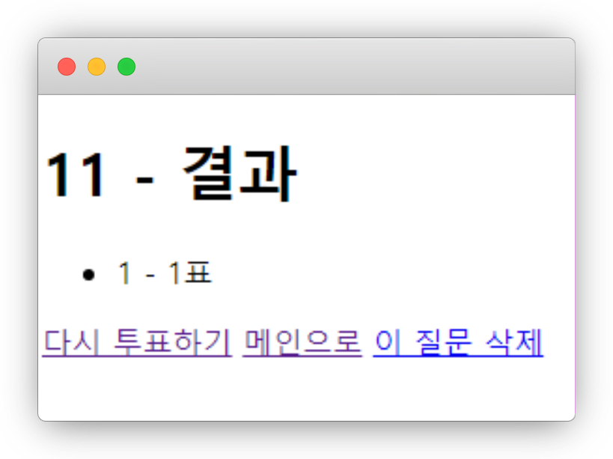
polls
localhost/polls/1/results

Slide 12
polls
helloworld/polls/urls.py
path('add/', views.add_question, name='add_question'),

Slide 13
polls
helloworld/polls/views.py
def add_question(request): question = Question(question_text=request.POST['question_text'], pub_date=datetime.datetime.now()) question.save() return HttpResponseRedirect(reverse('polls:index'))

Slide 14
polls
helloworld/polls/templates/polls/index.html
{% if lastest_question_list %} <h2>투표 목록</h2> <ul> {% for question in lastest_question_list %} <li><a href="/polls/{{question.id}}/">{{question.question_text}}</a></li> {% endfor %} </ul> {% else %} <p>등록된 투표가 없습니다.</p> {% endif %} <form action="{% url 'polls:add_question' %}" method="post"> {% csrf_token %} <input type="text" name="question_text" value="" /> <input type="submit" value="질문 추가하기"/> </form>

Slide 15
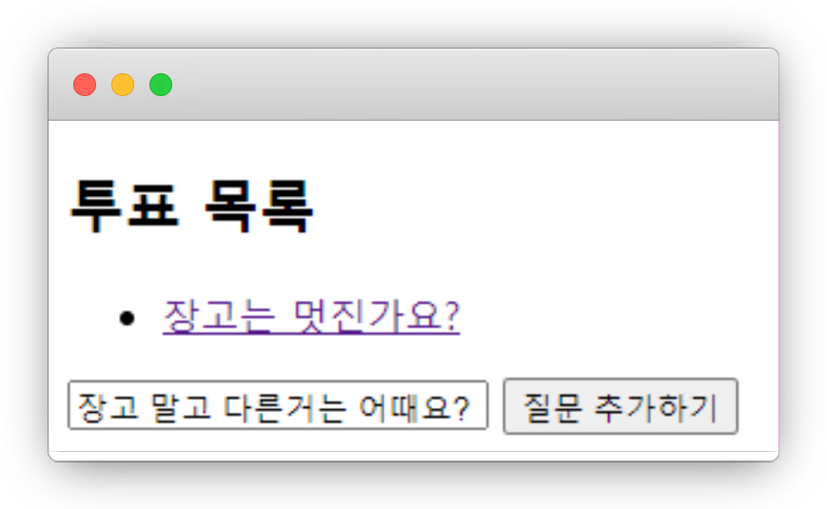
polls
localhost:9000/polls

Slide 16
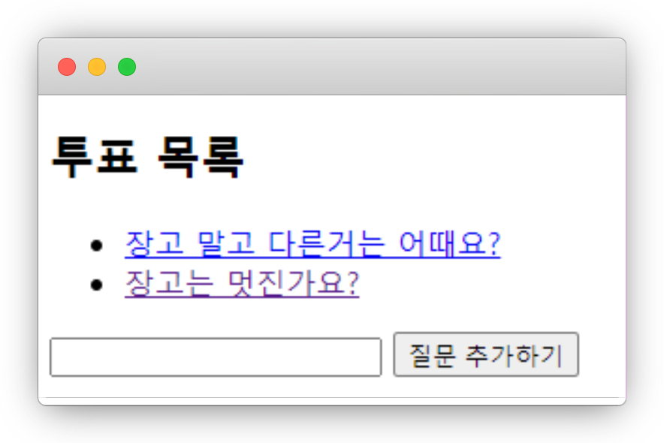
polls
localhost:9000/polls

Slide 17
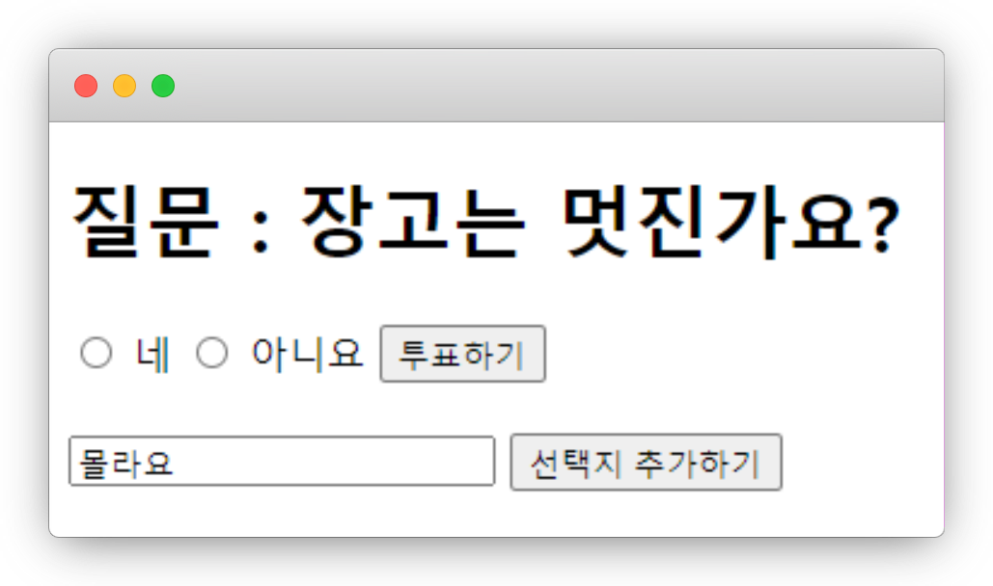
실습2
localhost:9000/polls/1

Slide 18
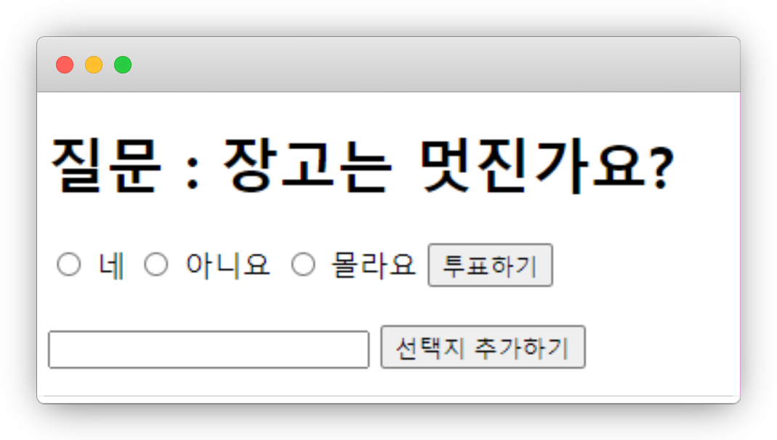
실습2
localhost:9000/polls/1

Slide 19
실습2
helloworld/polls/views.py
def add_choice(request, question_id): question = get_object_or_404(Question, pk=question_id) choice = Choice(question=question, choice_text=request.POST['choice_text'], votes=0) choice.save() return HttpResponseRedirect(reverse('polls:detail', args=(question.id,)))

Slide 20
실습2
helloworld/polls/urls.py
path('<int:question_id>/add', views.add_choice, name='add_choice'),

Slide 21
실습2
helloworld/polls/templates/polls/detail.html
<br> <form action="{% url 'polls:add_choice' question.id %}" method="post"> {% csrf_token %} <input type="text" name="choice_text" value="" /> <input type="submit" value="선택지 추가하기"/> </form>

Slide 22
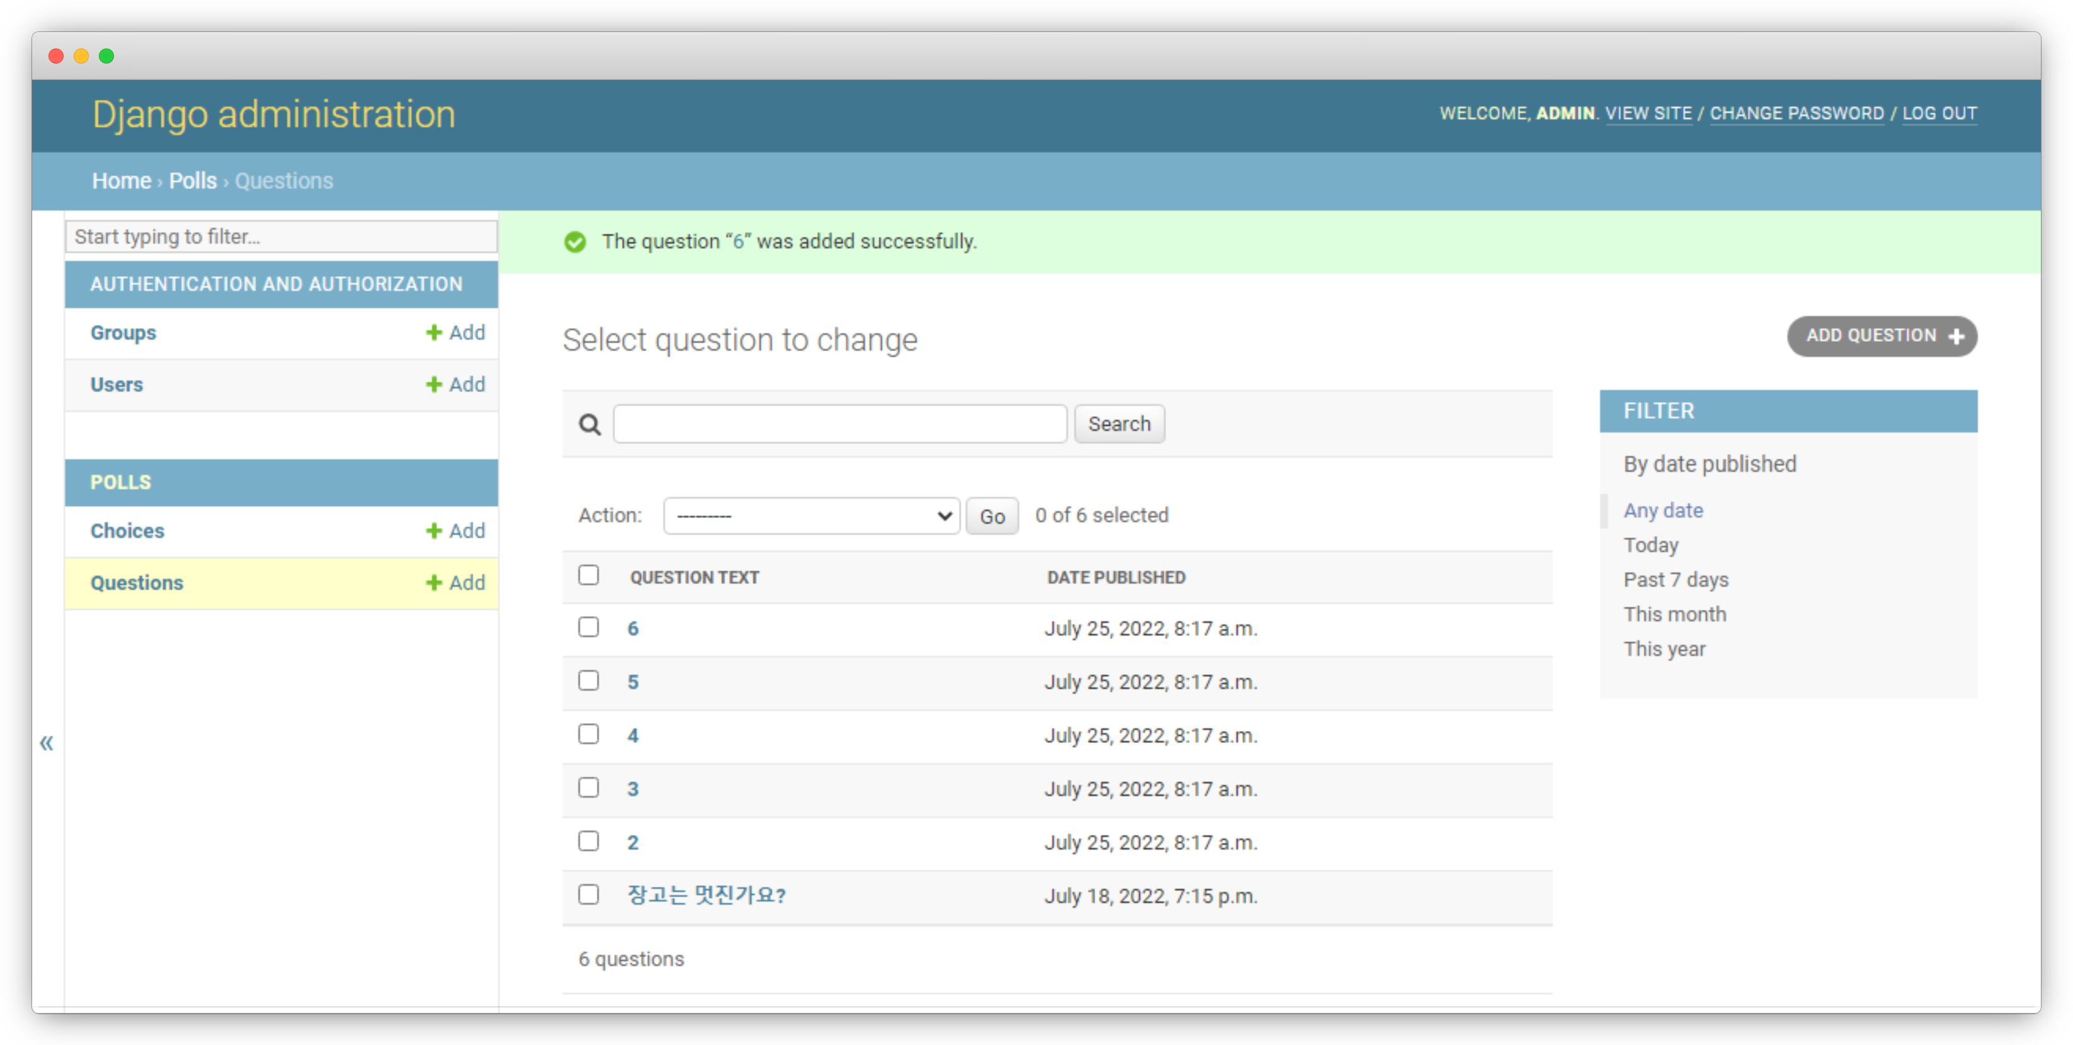
polls
localhost/polls

Slide 23
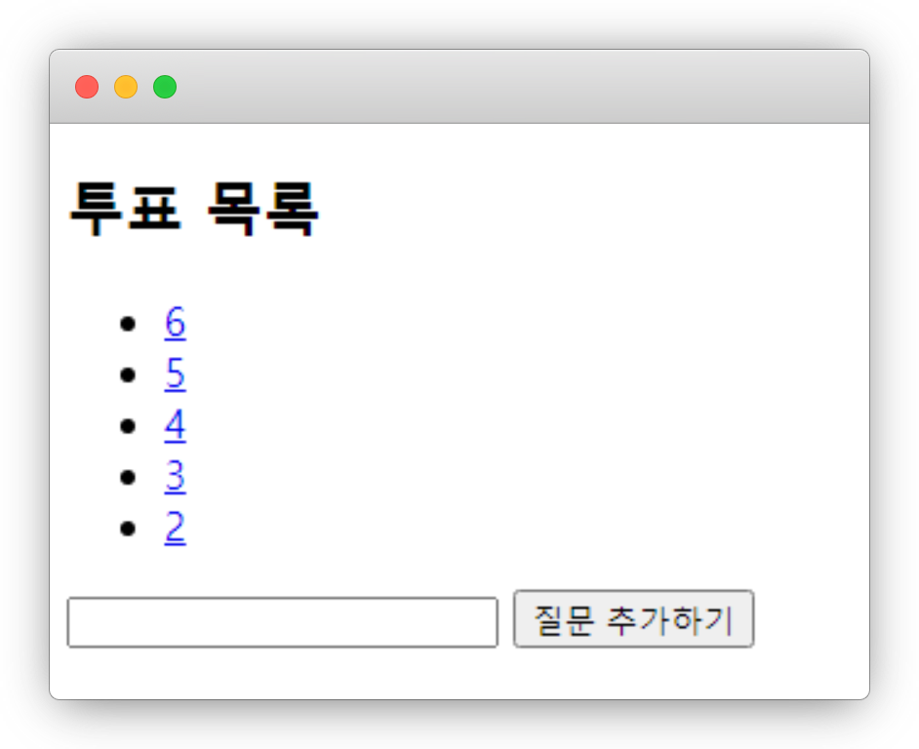
polls
localhost/polls

Slide 24
polls
URL
Path Parameter
Form
Body
Query Parameter

Slide 25
polls
request.GET.get('page', 1)

Slide 26
polls
helloworld/polls/views.py
def index(request): page = int(request.GET.get('page', 1)) lastest_question_list = Question.objects.all().order_by('-pub_date')[page * 5 - 5:][:5] return render(request, 'polls/index.html', {'lastest_question_list': lastest_question_list})

Slide 27
polls
localhost/polls

Slide 28
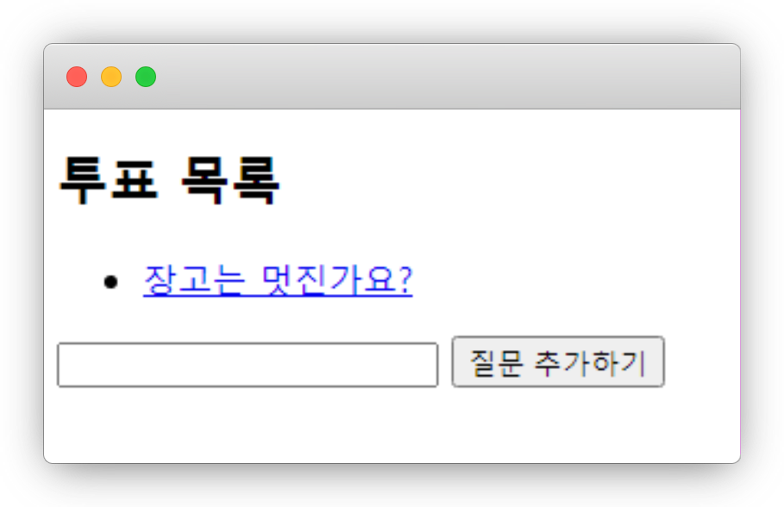
polls
localhost/polls/?page=2

Slide 29
polls
helloworld/polls/views.py
def index(request): page = int(request.GET.get('page', 1)) lastest_question_list = Question.objects.all().order_by('-pub_date')[page * 5 - 5:][:5] return render(request, 'polls/index.html', {'lastest_question_list': lastest_question_list, 'page': page, 'maxpage': len(Question.objects.all()) // 5 + 1})

Slide 30
polls
helloworld/polls/templates/polls/index.html
<br> {% for choice in ''|center:maxpage %} {% if page == forloop.counter %} <span>{{forloop.counter}}</span> {% else %} <a href="{% url 'polls:index' %}?page={{forloop.counter}}">{{forloop.counter}}</a> {% endif %} {% endfor %}

Slide 31
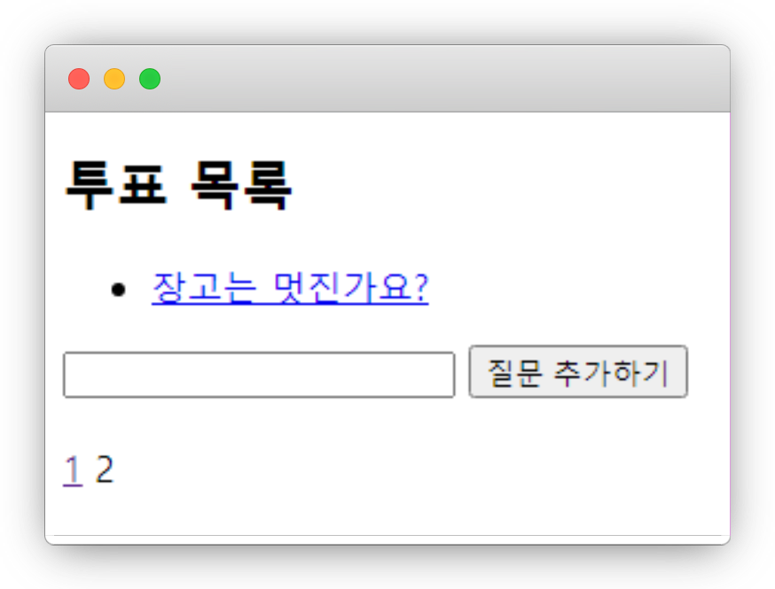
polls
localhost/polls/?page=2

Slide 32
템플릿
템플릿 변수
{{ var }}

Slide 33
템플릿
템플릿 필터
{{ var|filter:args }}

Slide 34
템플릿
템플릿 필터
{{ name|lower }}

Slide 35
템플릿
템플릿 필터
lower - 소문자화
truncatewords -자름
join – 리스트 join
default - 기본값
length - 길이
striptags - 이스케이프
pluralize – 복수접미사
add - 더하기
center - 중앙정렬
slice - 자르기
pprint - 디버깅
time - 시간
…

Slide 36
템플릿
템플릿 태그
{% tag %}

Slide 37
템플릿
템플릿 태그
{% for 원소 in 리스트 %}
…
{% endfor %}
forloop.couter – 반복횟수(1부터)
forloop.couter0 – 반복횟수(0부터)
forloop.revcouter – 반복횟수 역순
forloop.revcouter0 – 반복역순 0-
forloop.first – 처음
forloop.last – 마지막
forloop.parentloop – 상위 루프

Slide 38
템플릿
템플릿 태그
{% if 조건문 %}
…
{% elif 조건문 %}
…
{% else %}
…
{% endif %}

Slide 39
템플릿
템플릿 태그
{% csrf_token %}

Slide 40
템플릿
템플릿 태그
{% url ‘링크’ 파라미터 %}

Slide 41
템플릿
템플릿 태그
{% with 변수=실행식 %}
… {{변수}} …
{% endwith %}

Slide 42
템플릿
템플릿 태그
{# 주석 #}
{% comment %}
여러줄 주석
{% endcomment %}

Slide 43
템플릿
템플릿 상속
{% block 이름 %}
내용
{% endblock %}
{% extends “파일이름” %}

Slide 44
템플릿
helloworld/polls/templates/polls/layout.html
<!DOCTYPE html> <html lang=“ko"> <head> <meta charset="UTF-8"> <title>투표</title> </head> <body> <h1>{% block title %}투표{% endblock %}</h1> <hr> {% block content %} {% endblock %} </body> </html>

Slide 45
템플릿
helloworld/polls/templates/polls/index.html
{% extends "polls/layout.html" %} {% block content %}
…
{% endblock%}

Slide 46
템플릿
helloworld/polls/templates/polls/detail.html
{% extends "polls/layout.html" %}
{% block title %}질문 : {{question.question_text}}{% endblock %}} {% block content %}
…
{% endblock%}

Slide 47
템플릿
helloworld/polls/templates/polls/results.html
{% extends "polls/layout.html" %} {% block title %}{{question.question_text}} - 결과{% endblock %}} {% block content %}
…
{% endblock%}

Slide 48
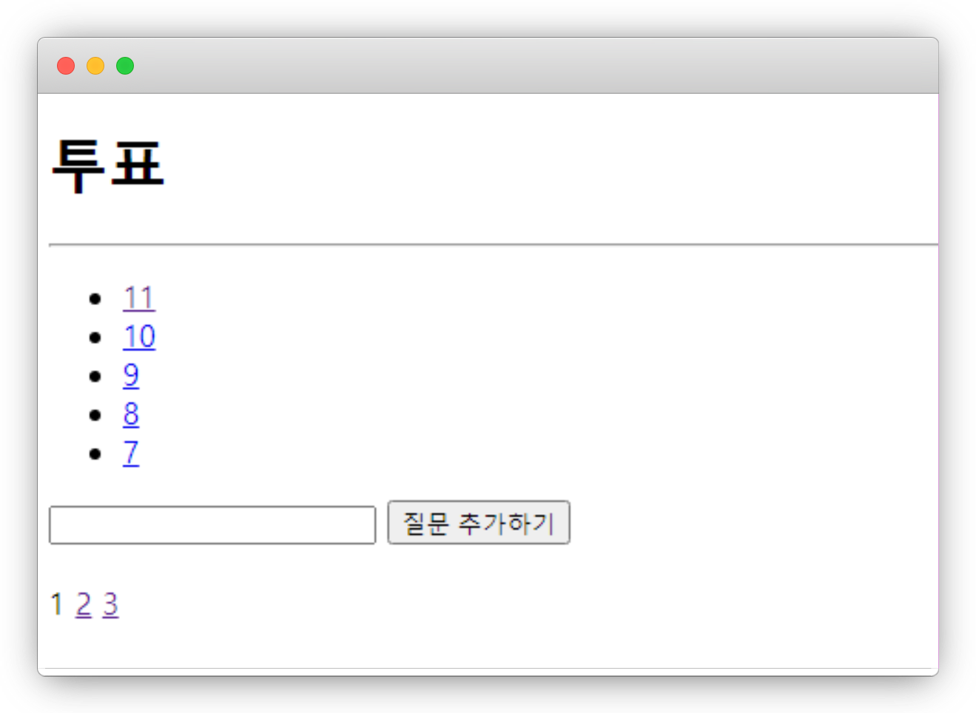
템플릿
localhost/polls

Slide 49
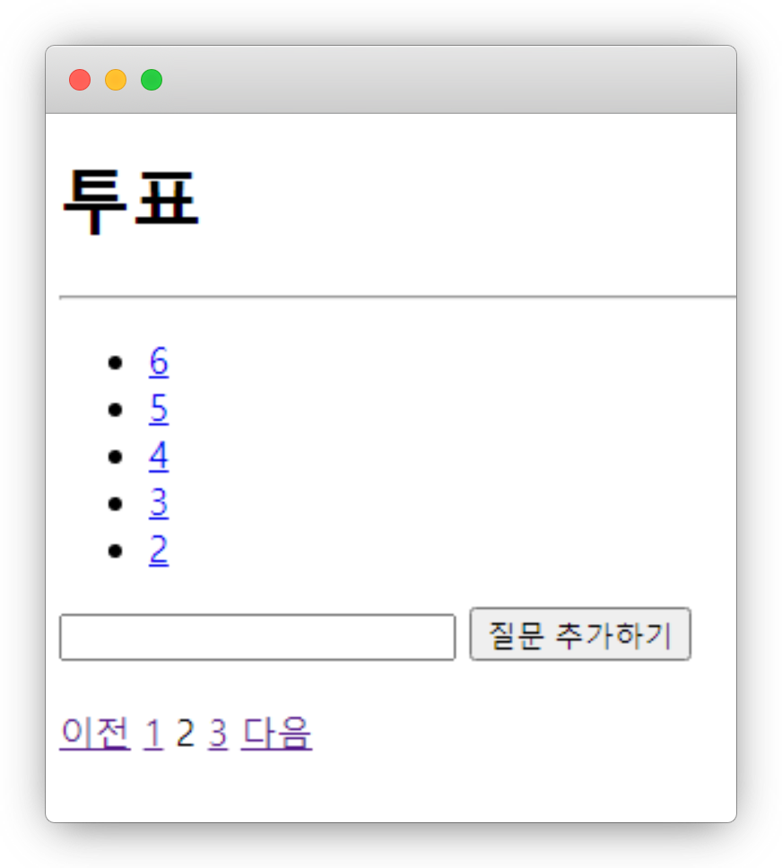
실습3
localhost/polls/?page=2

Slide 50
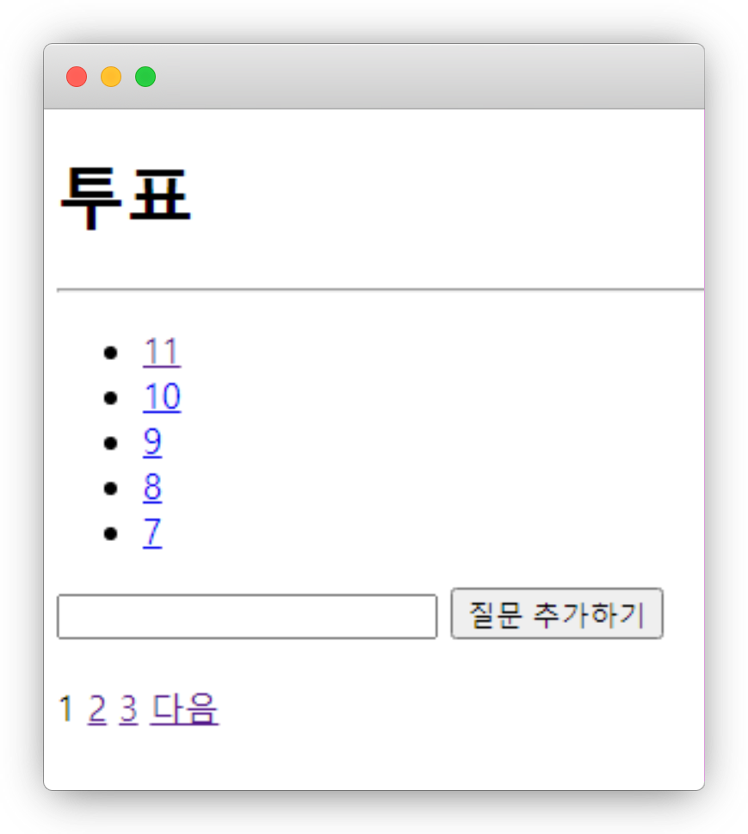
실습3
localhost/polls/?page=1

Slide 51
실습3
helloworld/polls/templates/polls/index.html
{% if page > 1 %} <a href="{% url 'polls:index' %}?page={{page|add:-1}}">이전</a> {% endif %}
…
{% if page < maxpage %} <a href="{% url 'polls:index' %}?page={{page|add:1}}">다음</a> {% endif %}

Slide 52
장고
django-admin startproject helloworld

Slide 53
장고
django-admin startapp youtuber

Slide 54
장고
python manage.py makemigrations
python manage.py migrate

Slide 55
장고
helloworld/settings.py
INSTALLED_APPS = [
'django.contrib.admin’,
'django.contrib.auth’,
'django.contrib.contenttypes’,
'django.contrib.sessions’,
'django.contrib.messages’,
'django.contrib.staticfiles’,
'main’,
]

Slide 56
장고
python manage.py runserver

Slide 57
polls
helloworld/polls/admin.py
from django.contrib import admin from polls.models import Question, Choice # Register your models here. admin.site.register(Question) admin.site.register(Choice)

Slide 58
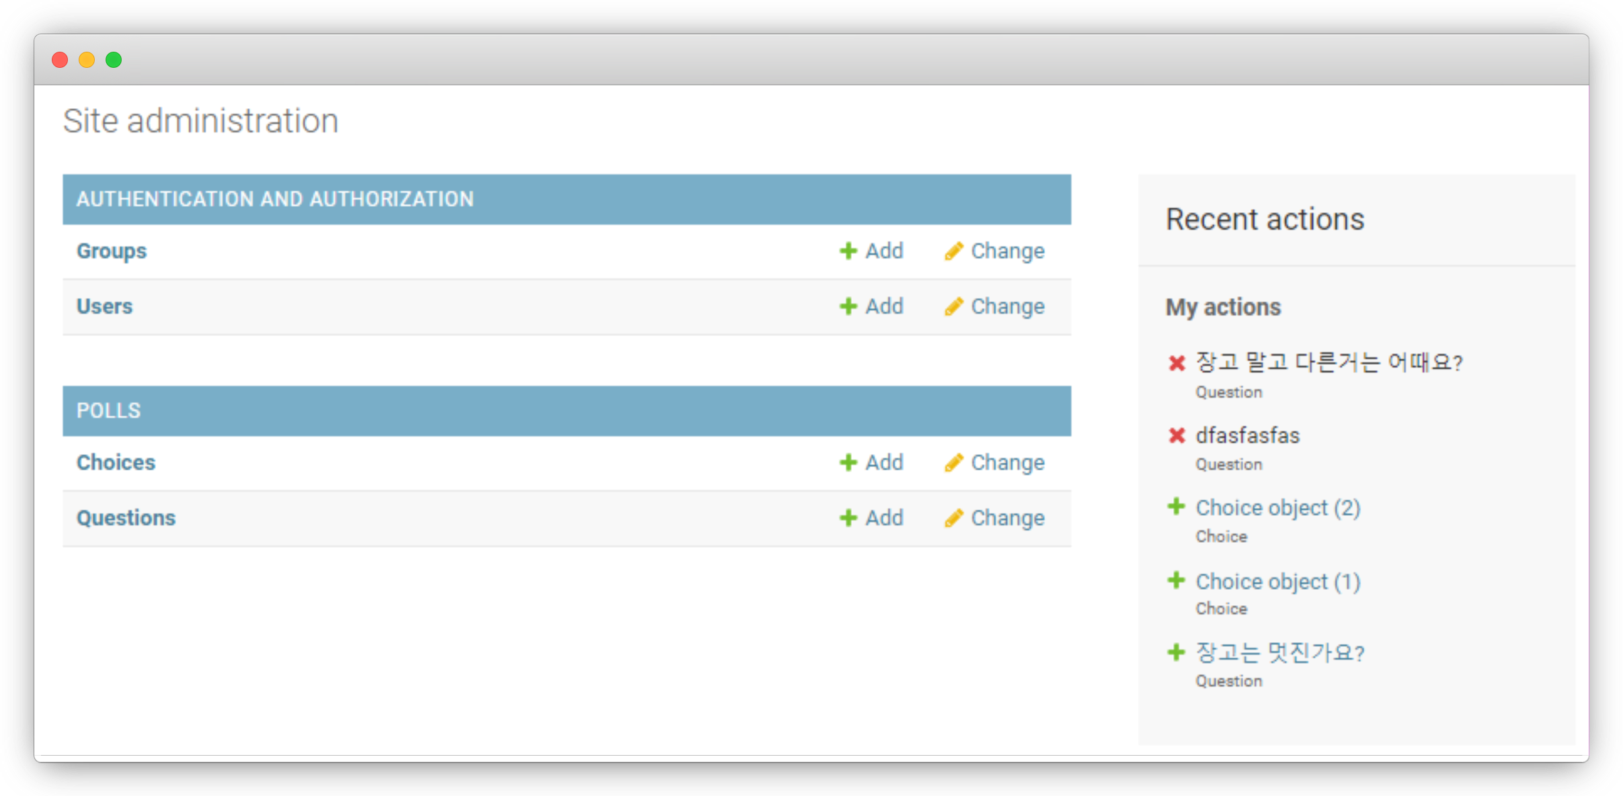
polls
localhost/admin

Slide 59
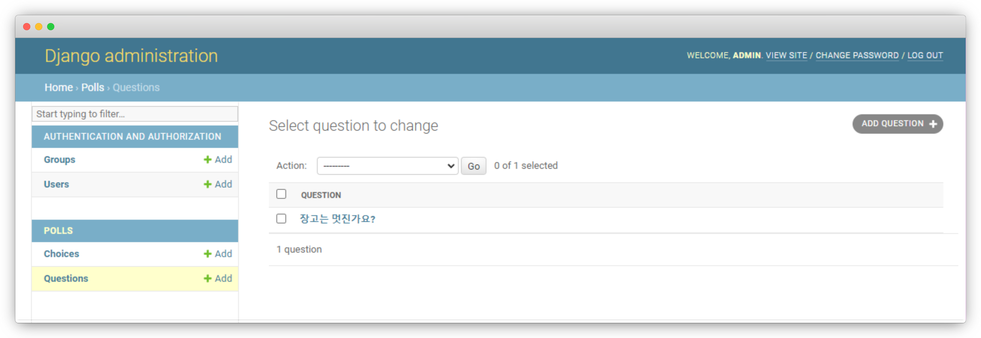
polls
localhost/admin

Slide 60
polls
helloworld/polls/models.py
class Choice(models.Model): question = models.ForeignKey(Question, on_delete=models.CASCADE) choice_text = models.CharField(max_length=200) votes = models.IntegerField(default=0) def __str__(self): return self.choice_text

Slide 61
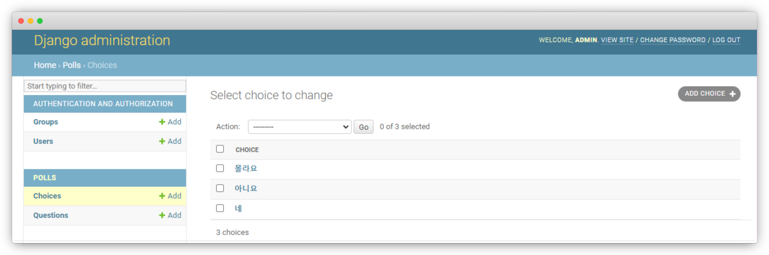
polls
localhost/admin

Slide 62
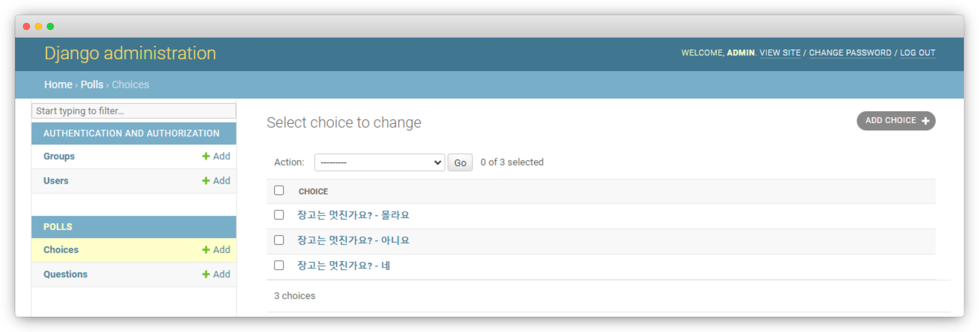
실습4
localhost/admin

Slide 63
실습4
helloworld/polls/models.py
class Choice(models.Model): question = models.ForeignKey(Question, on_delete=models.CASCADE) choice_text = models.CharField(max_length=200) votes = models.IntegerField(default=0) def __str__(self): return self.question.question_text + ' - ' + self.choice_text

Slide 64
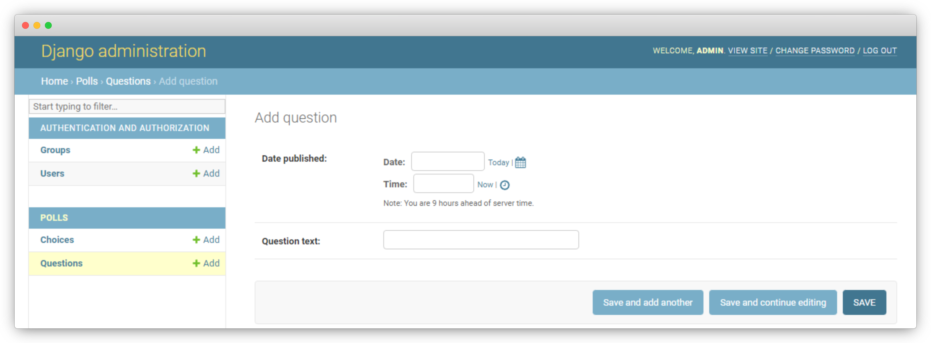
polls
localhost/admin

Slide 65
polls
helloworld/polls/admin.py
class QuestionAdmin(admin.ModelAdmin): fields = ['pub_date', 'question_text'] admin.site.register(Question)

Slide 66
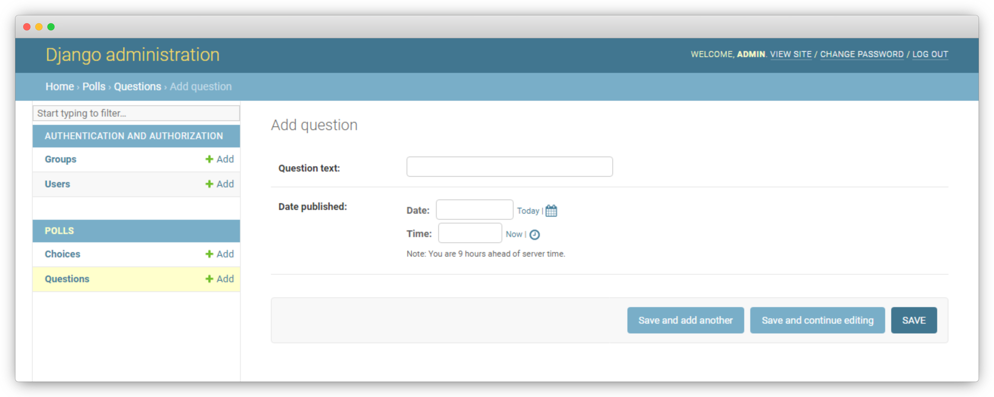
polls
localhost/admin

Slide 67
polls
helloworld/polls/admin.py
class QuestionAdmin(admin.ModelAdmin): fieldsets = [ ('질문', {'fields': ['question_text']}), ('작성 일자', {'fields': ['pub_date']}), ]

Slide 68
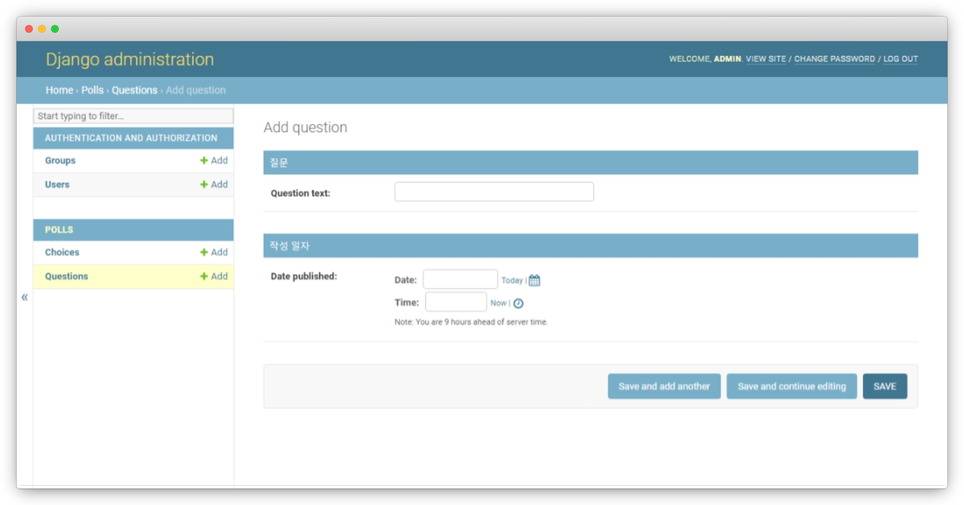
polls
localhost/admin

Slide 69
polls
helloworld/polls/admin.py
class QuestionAdmin(admin.ModelAdmin): fieldsets = [ ('질문', {'fields': ['question_text']}), ('작성 일자', {'fields': ['pub_date'], 'classes': ['collapse']}), ]

Slide 70
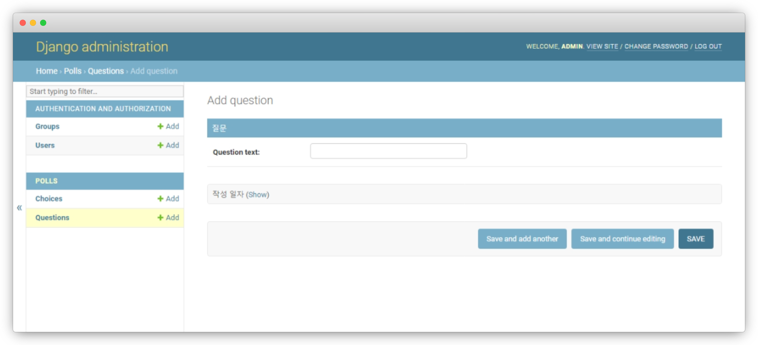
polls
localhost/admin

Slide 71
polls
helloworld/polls/admin.py
class ChoiceInline(admin.StackedInline): model = Choice extra = 2 class QuestionAdmin(admin.ModelAdmin): fieldsets = [ ('질문', {'fields': ['question_text']}), ('작성 일자', {'fields': ['pub_date'], 'classes': ['collapse']}), ] inlines = [ChoiceInline]

Slide 72
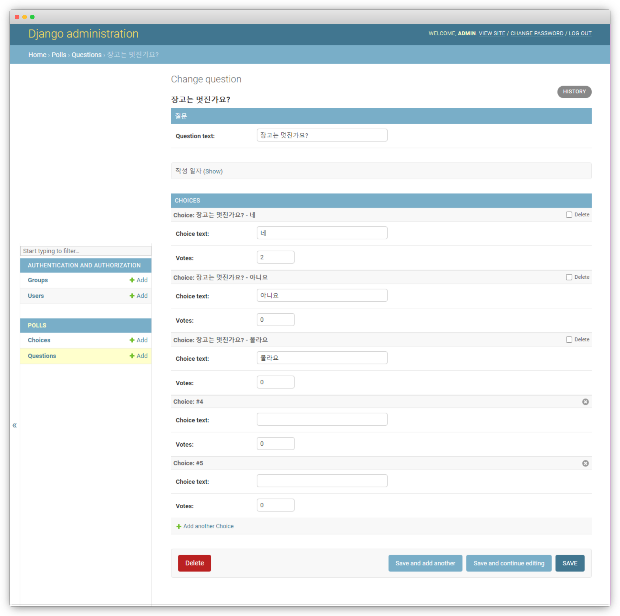
polls
localhost/admin

Slide 73
polls
helloworld/polls/admin.py
class ChoiceInline(admin.TabularInline): model = Choice extra = 2

Slide 74
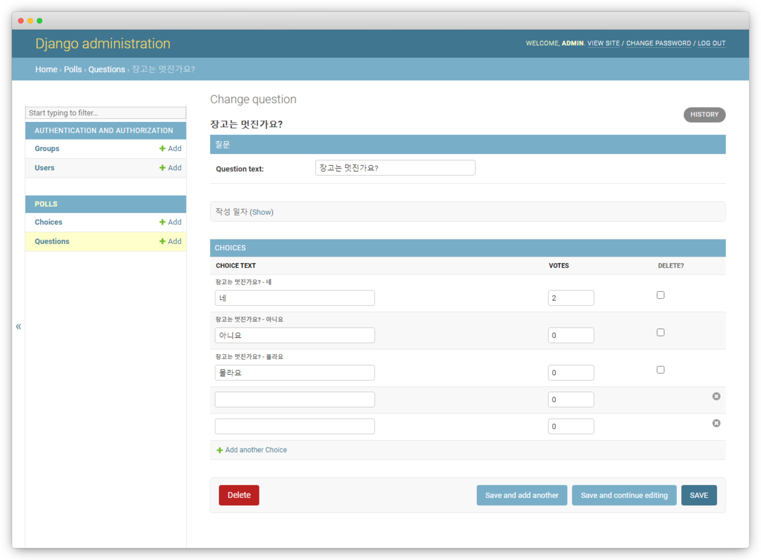
polls
localhost/admin

Slide 75
polls
helloworld/polls/admin.py
class QuestionAdmin(admin.ModelAdmin): fieldsets = [ ('질문', {'fields': ['question_text']}), ('작성 일자', {'fields': ['pub_date'], 'classes': ['collapse']}), ] inlines = [ChoiceInline] list_display = ('question_text', 'pub_date')

Slide 76
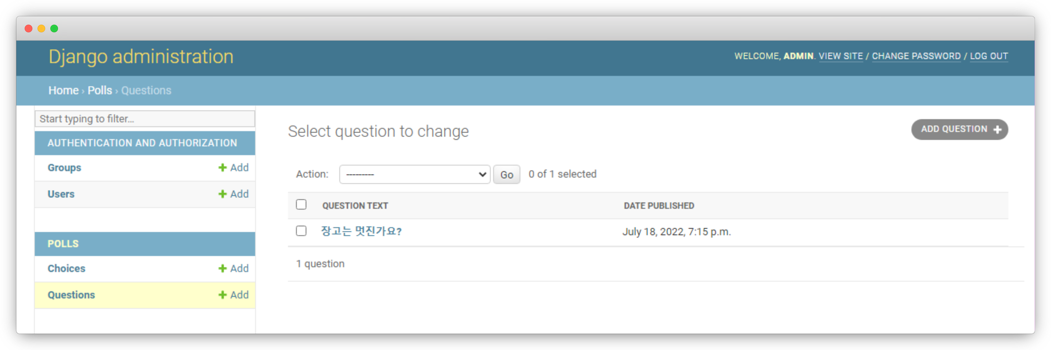
polls
localhost/admin

Slide 77
polls
helloworld/polls/admin.py
class QuestionAdmin(admin.ModelAdmin): fieldsets = [ ('질문', {'fields': ['question_text']}), ('작성 일자', {'fields': ['pub_date'], 'classes': ['collapse']}), ] inlines = [ChoiceInline] list_display = ('question_text', 'pub_date') list_filter = ['pub_date']

Slide 78
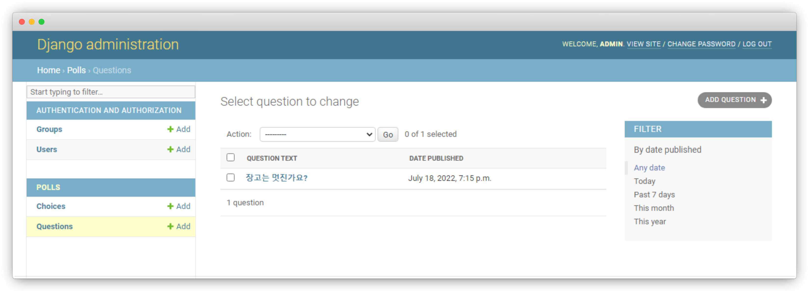
polls
localhost/admin

Slide 79
polls
helloworld/polls/admin.py
class QuestionAdmin(admin.ModelAdmin): fieldsets = [ ('질문', {'fields': ['question_text']}), ('작성 일자', {'fields': ['pub_date'], 'classes': ['collapse']}), ] inlines = [ChoiceInline] list_display = ('question_text', 'pub_date') list_filter = ['pub_date'] search_fields = ['question_text']

Slide 80
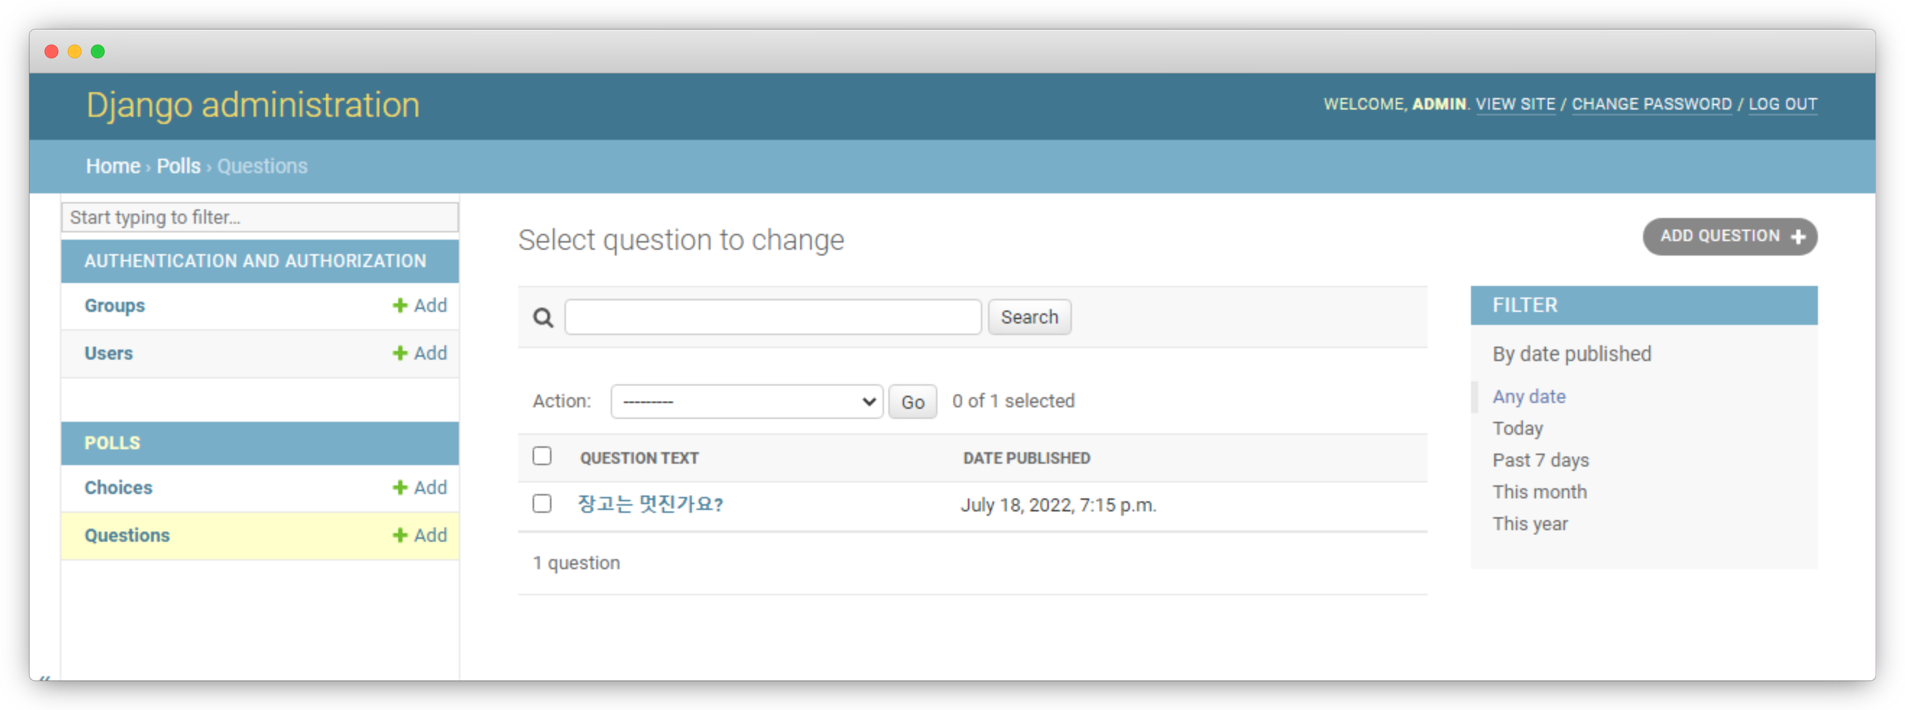
polls
localhost/admin

Slide 81
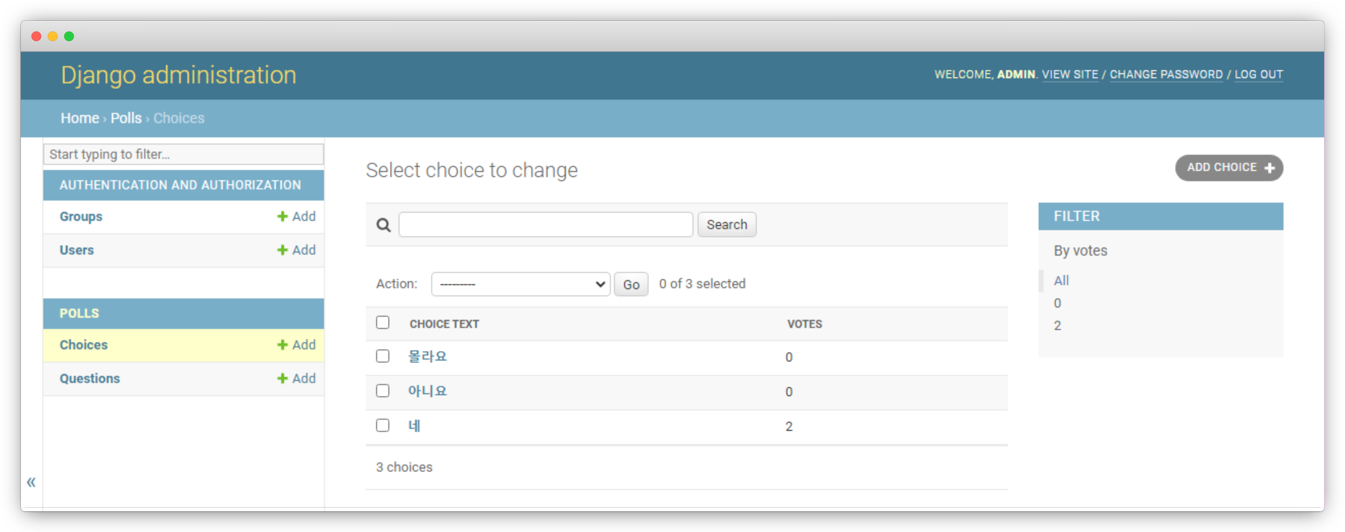
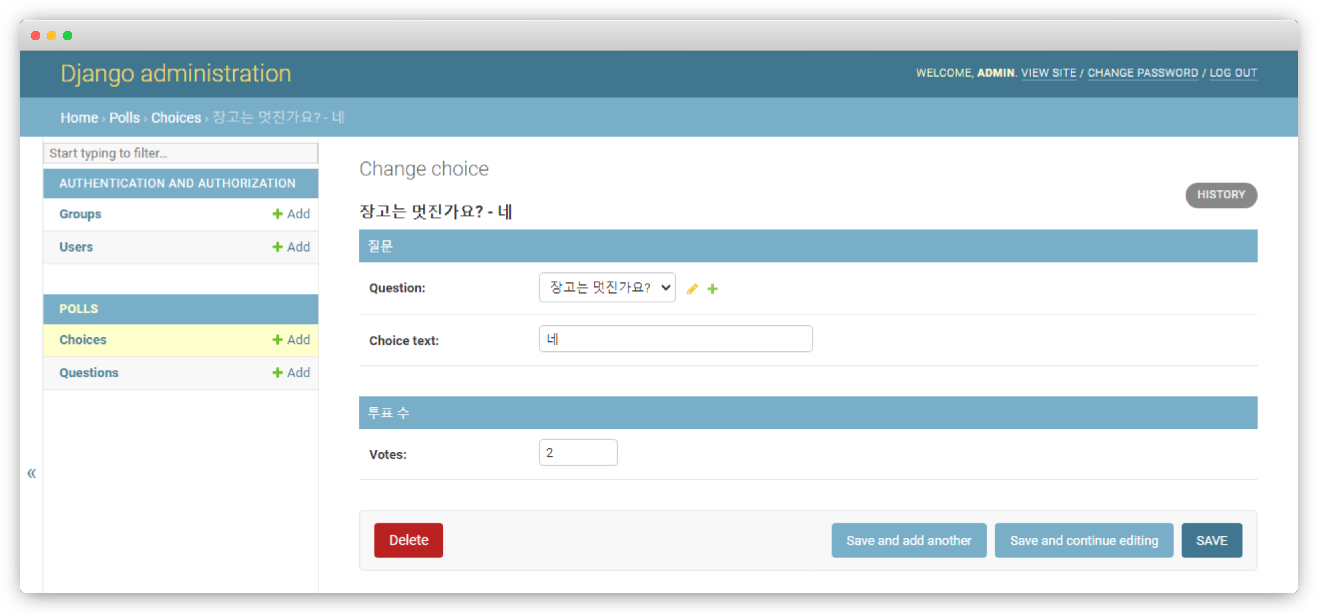
실습5
localhost/admin

Slide 82
실습5
helloworld/polls/admin.py
class ChoiceAdmin(admin.ModelAdmin): fieldsets = [ ('질문', {'fields': ['question', 'choice_text']}), ('투표 수', {'fields': ['votes']}), ] list_display = ('choice_text', 'votes') list_filter = ['votes'] search_fields = ['choice_text'] admin.site.register(Choice,ChoiceAdmin)

Slide 83
실습6
꾸며보기!

Slide 84
실습6
helloworld/polls/templates/polls/layout.html
<head> <meta charset="UTF-8"> <title>투표</title> {% load static %} <link rel="stylesheet" type="text/css" href="{% static 'polls/style.css' %}"> </head>

Slide 85
실습6
helloworld/polls/static/polls/style.css
<style> 태그 안의 내용 여기에 작성!

Slide 86
실습6
서버 재시작

Slide 87
blog
새로운 앱!

Slide 88
blog
함수형 뷰
클래스형 뷰

Slide 89
blog
Post
id
integer, AutoIncrement, PK
content
TextField, 내용
title
varchar(50), 제목
create_dt
dateTimeField, 작성일자
slug
Slug, unique, 주소
modify_dt
dateTimeField, 수정일자
description
varchar(100), 부제목

Slide 90
blog
helloworld/blog/models.py
from django.db import models from django.urls import reverse class Post(models.Model): title = models.CharField('제목', max_length=50) slug = models.SlugField('슬러그', allow_unicode=True, unique=True) description = models.CharField('설명', max_length=100, blank=True) content = models.TextField('내용') create_dt = models.DateTimeField('작성일', auto_now_add=True) modify_dt = models.DateTimeField('수정일', auto_now=True)

Slide 91
blog
helloworld/blog/models.py
class Post(models.Model): def __str__(self): return self.title def get_absolute_url(self): return reverse('blog:post_detail', args=(self.slug,)) def get_previous(self): return self.get_previous_by_modify_dt()

Slide 92
blog
helloworld/blog/models.py
class Post(models.Model): class Meta: verbose_name = '게시글' verbose_name_plural = '게시글' db_table = 'blog_post' ordering = ['-modify_dt']

Slide 93
blog
helloworld/blog/admin.py
from django.contrib import admin from blog.models import Post admin.site.register(Post)

Slide 94
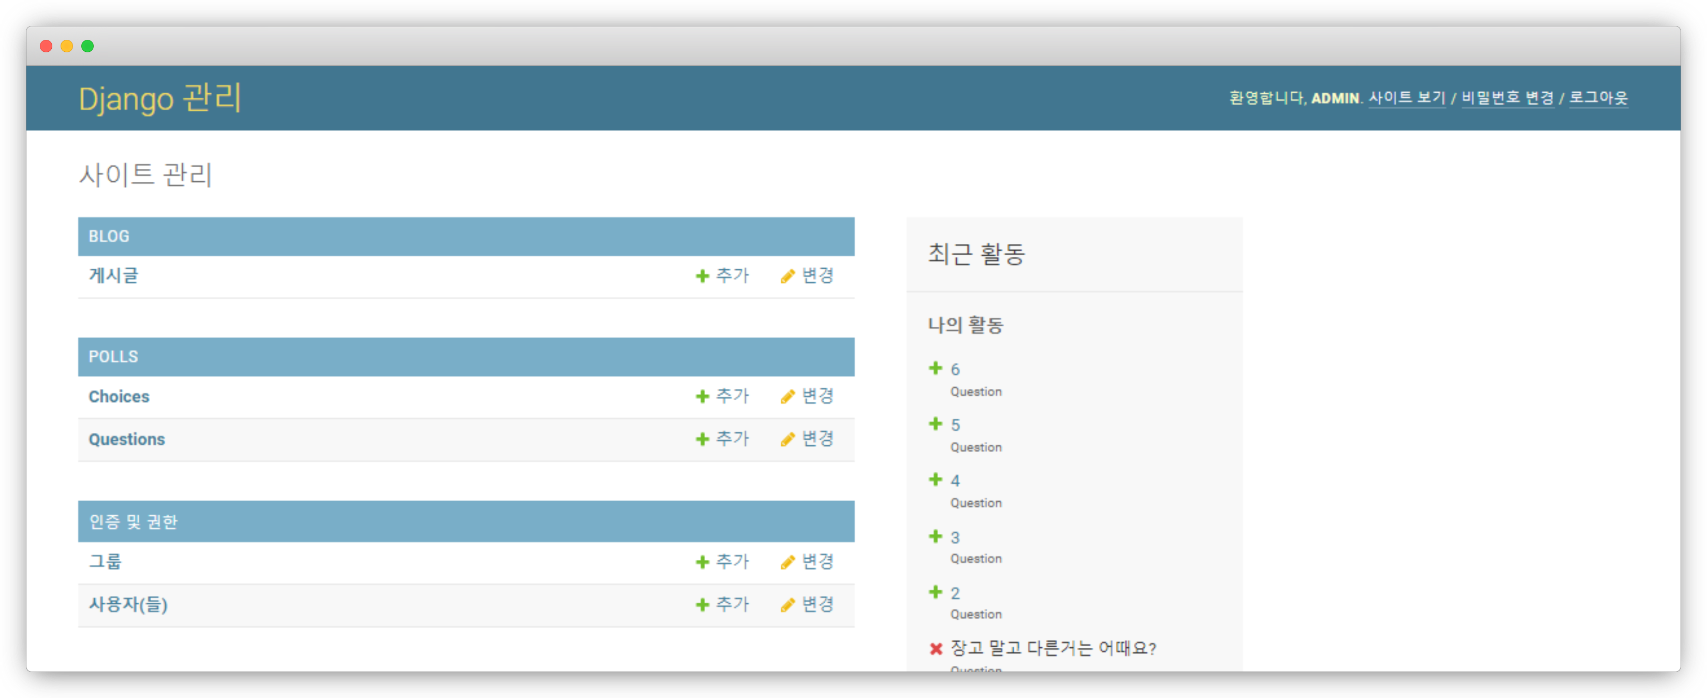
blog
localhost/admin

Slide 95
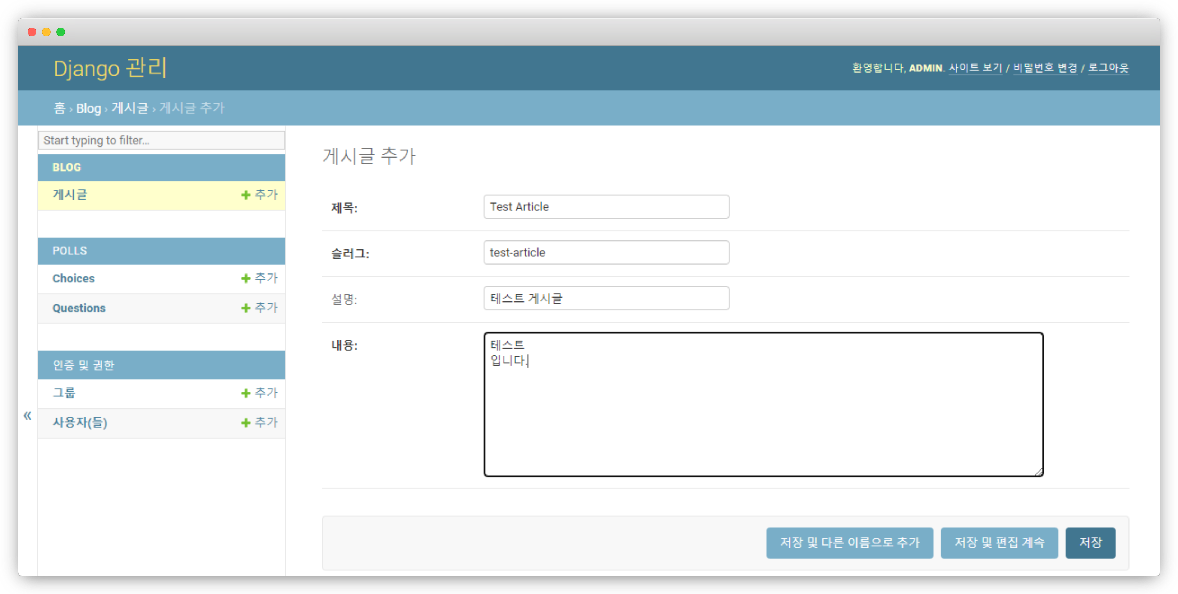
blog
localhost/admin

Slide 96
blog
helloworld/blog/urls.py
from django.urls import path from . import views urlpatterns = [ path('', views.PostLV.as_view(), name='index'), ] app_name = 'blog'

Slide 97
blog
helloworld/blog/views.py
from django.views.generic import ListView from blog.models import Post class PostLV(ListView): model = Post template_name = 'blog/post_list.html' context_object_name = 'posts' paginate_by = 2

Slide 98
blog
helloworld/blog/templates/blog/post_list.html
<h1>게시물</h1> <hr> {% for post in posts %} <a><h3>{{post.title}}</h3></a> <p>{{post.description}}</p> {% endfor %}

Slide 99
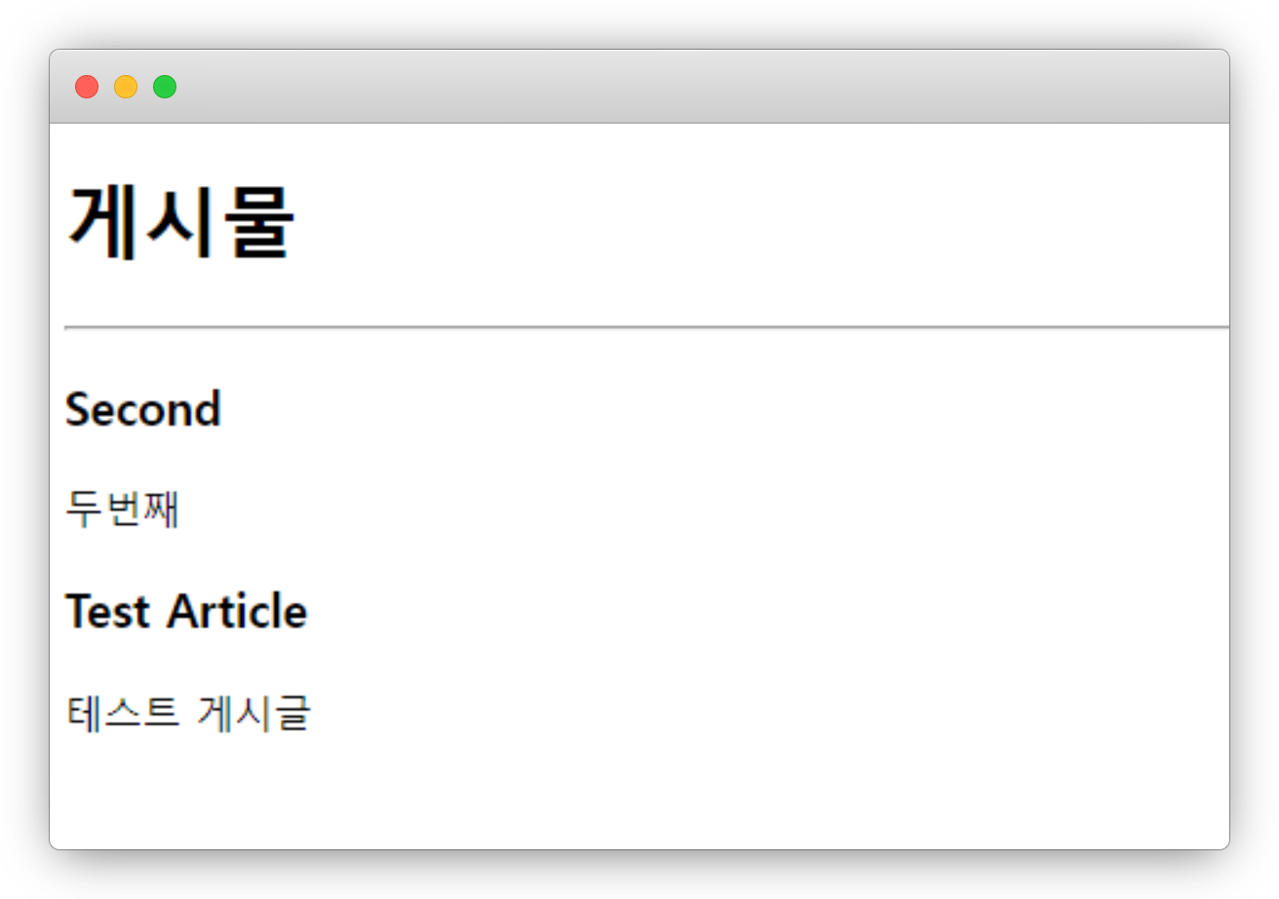
blog
localhost/blog

Slide 100
blog
helloworld/blog/templates/blog/post_list.html
{% if page_obj.has_previous %} <a href="?page={{page_obj.previous_page_number}}">이전</a> {% endif %} <span>페이지 {{page_obj.number}}/{{page_obj.paginator.num_pages}}</span> {% if page_obj.has_next %} <a href="?page={{page_obj.next_page_number}}">다음</a> {% endif %}

Slide 101
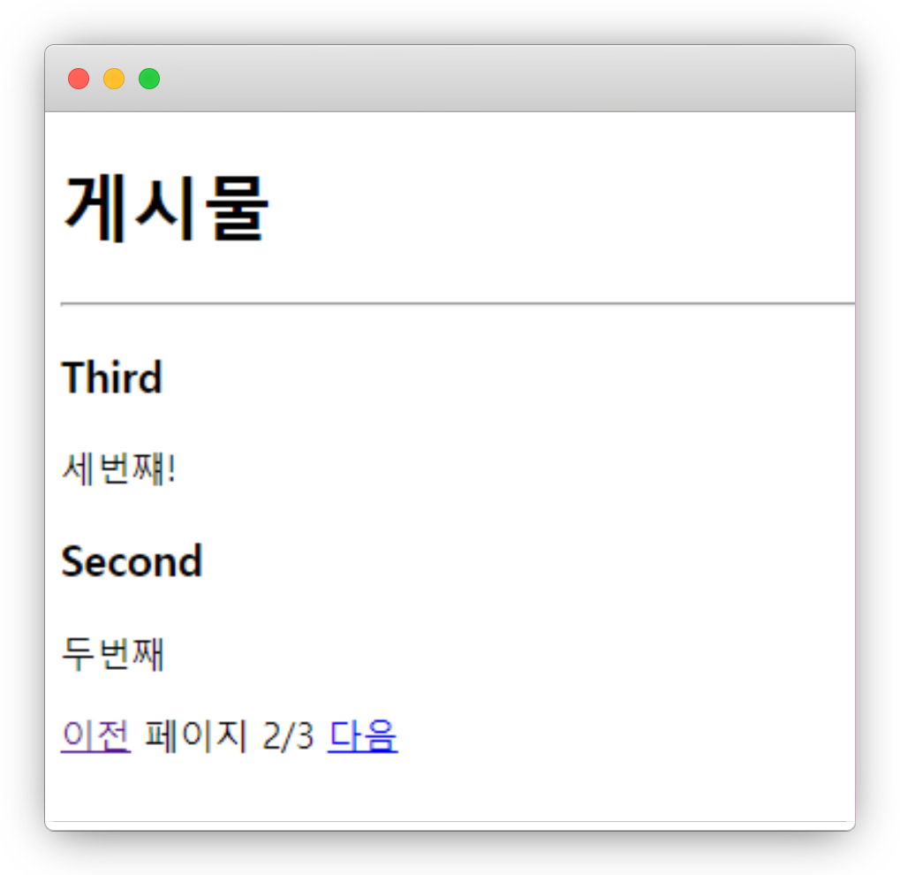
blog
localhost/blog

Slide 102
blog
helloworld/blog/urls.py
from django.urls import path, re_path from . import views urlpatterns = [ path('', views.PostLV.as_view(), name='index'), re_path(r'^post/(?P<slug>[-\w]+)/$', views.PostDV.as_view(), name='post_detail'), ]
app_name = 'blog'

Slide 103
blog
helloworld/blog/views.py
from django.views.generic import ListView, DetailView from blog.models import Post class PostDV(DetailView): model = Post template_name = 'blog/post_detail.html' context_object_name = 'post'

Slide 104
blog
helloworld/blog/templates/blog/post_list.html
<h1>게시물</h1> <hr> {% for post in posts %} <a href=“{{post.get_absolute_url}}”><h3>{{post.title}}</h3></a> <p>{{post.description}}</p> {% endfor %}

Slide 105
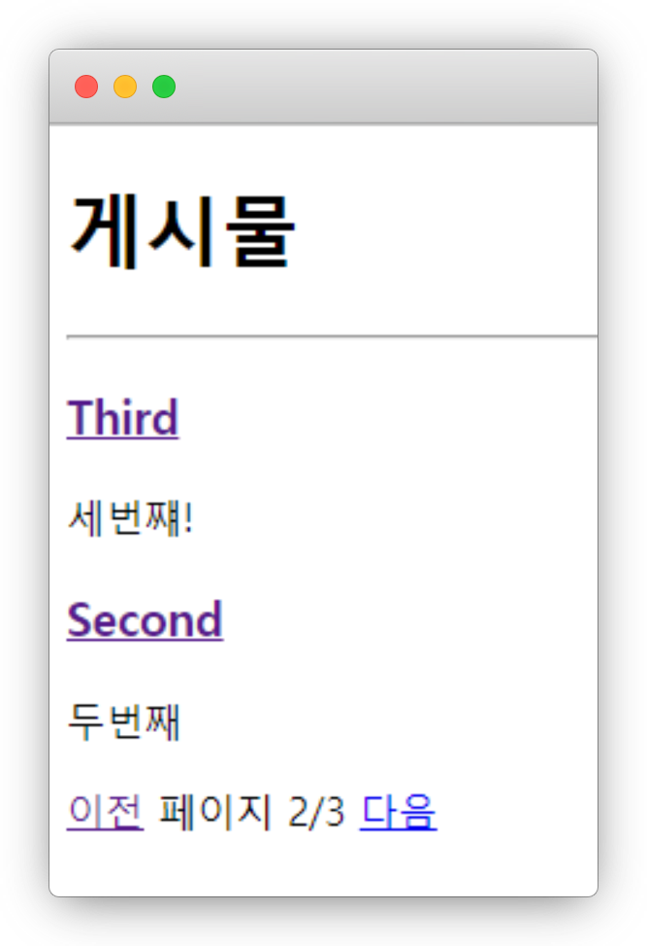
blog
localhost/blog

Slide 106
blog
helloworld/blog/templates/blog/post_detail.html
<h2>{{post.title}}</h2> <h3>{{post.description}}</h3> <span>작성일자 : {{post.modify_dt|date:"Y F j"}}</span> <div> {{post.content|linebreaks}} </div> {% if object.get_previous %} <a href="{{post.get_previous.get_absolute_url}}">이전 : {{object.get_previous}}</a> <br> {% endif %} {% if object.get_next %} <a href="{{post.get_next.get_absolute_url}}">다음 : {{object.get_next}}</a> {% endif %}

Slide 107
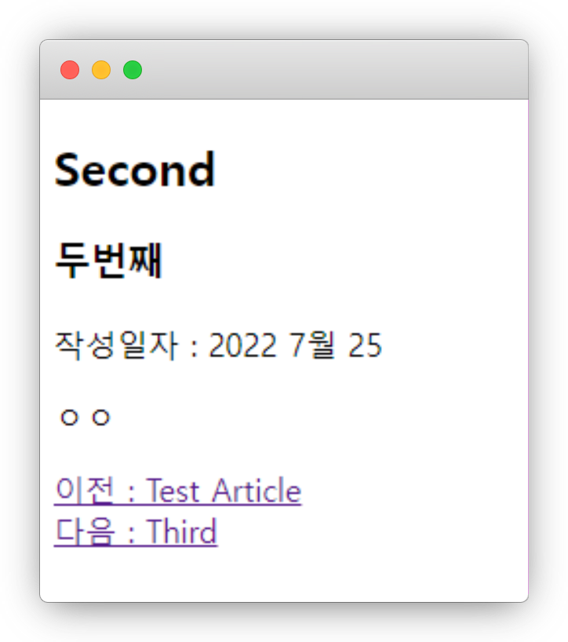
blog
localhost/blog

Slide 108
제네릭 뷰
클래스 -> 상속 가능!
장고에서 지원하는 내장 뷰
ListView, DetailView, …

Slide 109
제네릭 뷰
ListView – 객체의 리스트를 보여주는 뷰
DetailView – 객체 하나를 보여주는 뷰
RedirectView – 리다이렉트를 해주는 뷰
TemplateView – 단순 렌더링을 해주는 뷰

Slide 110
제네릭 뷰
FormView – 수정 폼을 보여주는 뷰
CreateView – 생성 뷰
UpdateView – 수정 뷰
DeleteView – 삭제 뷰

Slide 111
실습 7
polls -> 클래스형 뷰

Slide 112
실습 7
여기부터는 전체 코드 X!

Slide 113
실습 8
댓글 기능 구현!

Slide 114
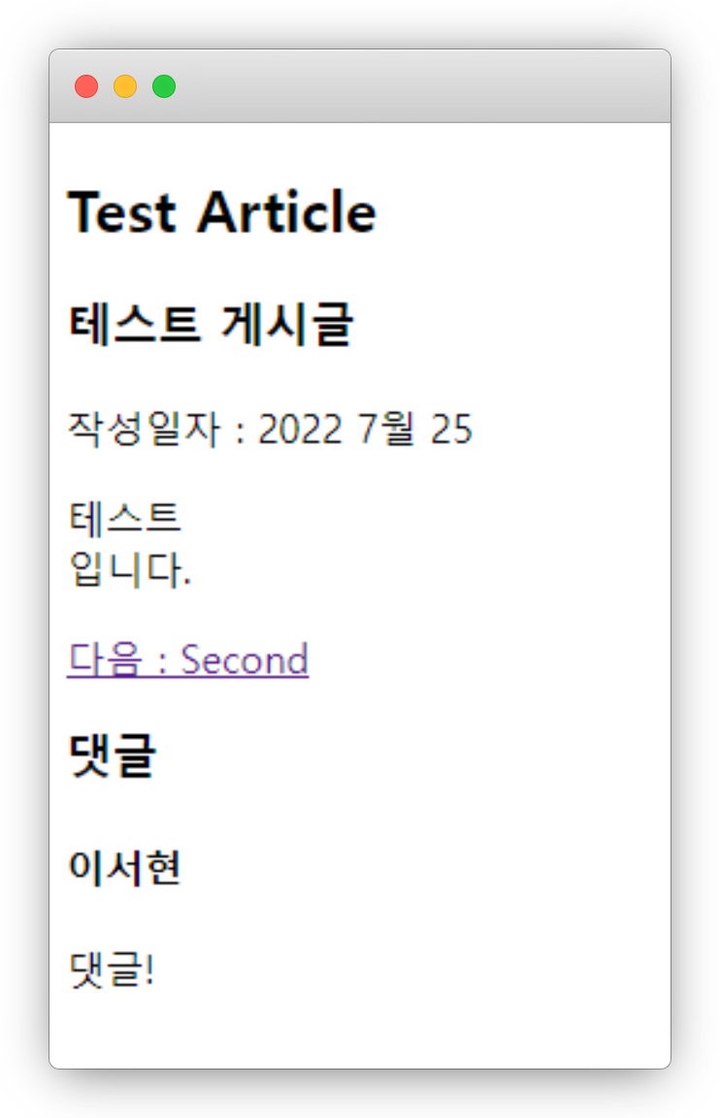
실습 8

Slide 115
실습 8
Comment
id
integer, AutoIncrement, PK
???
???
???
???

Slide 116
실습 8
Comment
id
integer, AutoIncrement, PK
content
TextField, 내용
post
Post(Foerign Key), 달린 글
create_dt
dateTimeField, 작성일자
writer
varchar(50), 작성자

Slide 117
실습 8
python manage.py makemigrations
python manage.py migrate

Slide 118
실습 8
from django.views.generic import ListView, DetailView, CreateView from blog.models import Post, Comment from django.urls import reverse_lazy
class CommentAdd(CreateView): model = Comment fields = ['name', 'email', 'body'] template_name = 'blog/comment_form.html' success_url = reverse_lazy('blog:post_detail')

Slide 119
다음 시간에는…
검색, 파일 업로드, 자바스크립트

Slide 120
웹 프로그래밍
한글과컴퓨터학원
조교 이서현

